Slide 1
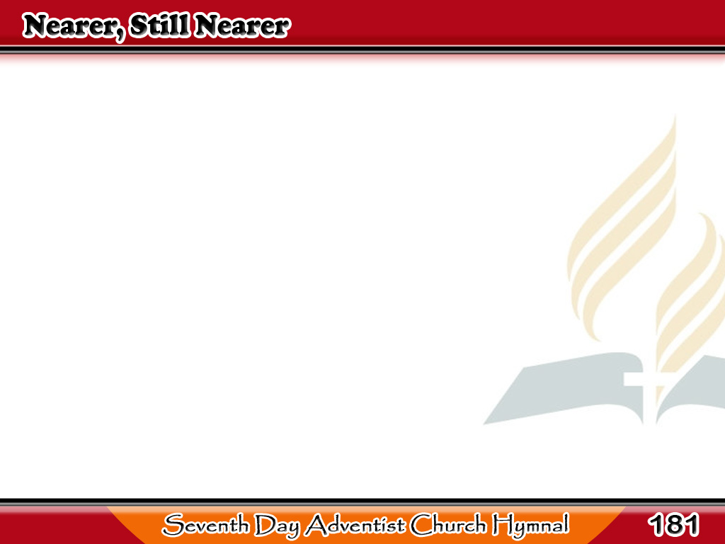
Ilapit Mo Ako
Nearer, still nearer,
close to Thy heart,
Draw me, my Savior,
so precious Thou art;
1/4

Slide 2
Ilapit Mo Ako
Fold me, O fold me
close to Thy breast,
Shelter me safe
1/4

Slide 3
Ilapit Mo Ako
in that haven of rest,
Shelter me safe
in that haven of rest.
1/4

Slide 4
Ilapit Mo Ako
Nearer, still nearer,
nothing I bring,
Nought as an offering
2/4

Slide 5
Ilapit Mo Ako
to Jesus my King
Only my sinful
now contrite heart;
2/4

Slide 6
Ilapit Mo Ako
Grant me the cleansing
Thy blood doth impart,
Grant me the cleansing
Thy blood doth impart.
2/4

Slide 7
Ilapit Mo Ako
Nearer, still nearer,
Lord, to be Thine;
Sin, with its follies,
I gladly resign,
3/4

Slide 8
Ilapit Mo Ako
All of its pleasures,
pomp and its pride;
Give me but Jesus,
3/4

Slide 9
Ilapit Mo Ako
my Lord crucified,
Give me but Jesus,
my Lord crucified.
3/4

Slide 10
Ilapit Mo Ako
Nearer, still nearer,
while life shall last;
Till safe in glory
my anchor is cast;.
4/4

Slide 11
Ilapit Mo Ako
Through endless ages,
ever to be,
Nearer, my Savior,
4/4

Slide 12
Ilapit Mo Ako
still nearer to Thee,
Nearer my Savior,
still nearer to Thee.
4/4

